Slide 1

AUTOMATING THE UNIVERSITY

Slide 2

Developed By:
Tarun Kumar

Slide 3


With the increasing number of students applying for Universities & Colleges, managing the work has become a tedious task.
This has led to a need to automate the admission & other working processes.
This project aims at the automation of the routine work of a University including admissions, managing results, providing information about the courses, information about the university & various different affiliated colleges and the faculty.
Thus, making all the essentials of a university available ONLINE

Slide 4


Automates a university by making its working online.
Provides a one stop shop for the existing as well as prospective students.
Current students can find out various information such as schedule of examination and other various important events, their results etc.
Prospective students can find out the list of colleges affiliated to the university, courses offered by them, admission procedure, discussion forums etc. Students can also download registration forms for applying for various courses, or can also apply online using the portal.

Slide 5

Administrators can login from their university or college login id (as the case maybe) & update or edit any information pertaining to the university or college respectively.
Using this login the administrator of each college can also select students for admission in their college depending on the cut off marks required for admission in the same.

Slide 6

Login Management: The purpose of this module is to provide login area for University Head and the administrator of the college. The University Head can add a faculty member, modify the faculty member, add and modify the course, add and modify the details of the affiliated college, uploads the result, prepares the list of students taking admission to university. The role of college administrator is to just check the students that have applied through university for various courses.
Online Admission: The purpose of this module is to make students apply online for various courses to various affiliated colleges under university and direct to the university as well.
Faculty Management: The purpose of this module is to maintain the records of various faculties in the university and also to keep the record of all the faculty members in different faculties..

Slide 7
Result Management: The purpose of this module is to show the results of various courses under various semesters to the students online.
College Management: The purpose of this module is to keep records of all the colleges affiliated to the university, various courses offered by the colleges and display the information to viewers accordingly.

Slide 8

Front End
Java Server Pages
User friendly
GUI
Separation of work (designing & coding)
Written once run anywhere
Middle-Tier
Java Beans
Back End
Oracle/Access
Security
Performance
Scalability
Reliability
Support RDBMS concepts

Slide 9
Hardware :
Processor 800 Ghz
RAM 128MB
Hard Disk 20GB/40GB
Software :
Front End Html/JSP
Back End MySQL/SQL Server/Access

Slide 10

Fully works online.
Reduces the time in all university management.
Centralized maintenance of all information.
Easy to search the information.
Secure.
Reliable.

Slide 11

View profile
Submit Follow up Remarks Details
Faculty
Enter Enquiry Details
Counselors
Query Status
Submit Query Criteria.
University Portal
Summit complain
View Query Result
View Follow up Reports
View Result, faculty profile, exam schedule, syllabus etc..
Enter Registration Details
Submit request
View Reports
Student
Chancellor

Slide 12
User
Enter login & pass
Admin
Get Response
Login
Send Request, Get Response
Send request for visit
If login true then Enter into process section
Result
University Portal
Store Result
Retrieve Result
verification
Send request
Send complain
Fill entries of exam form
Exam Form
Complain
Registration
Get response
Fill entries of registration form
Get response
Student
Fill entries of exam form

Slide 13

Password
Inquiry
Login
User
Answer
Name
Belongs
Has-A
Admin
Name
Type
University
Campus
Has-A
Department
Subject
Courses
Faculty
Belongs
University Record
Exam
Affiliated
Code
Marks
Book Name
Name
Password
Library
Writer Name
Address
Institutes
Issue Date
Institute Code
Description
University
Courses
No of Books

Slide 14


Slide 15

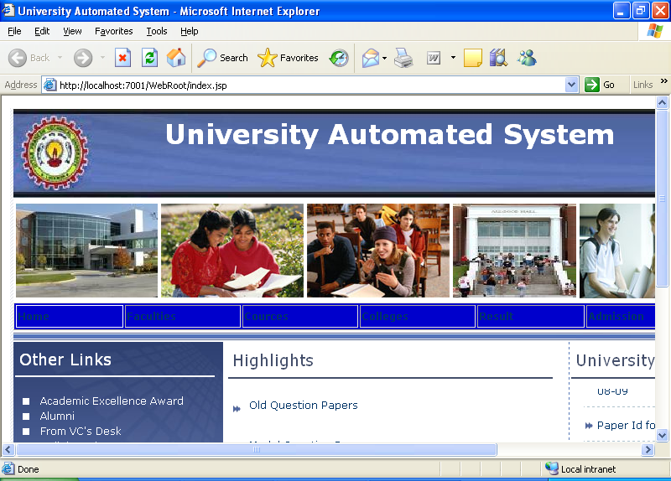

Slide 16

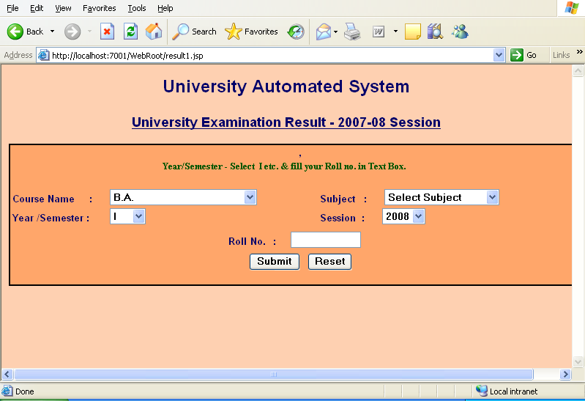

Slide 17

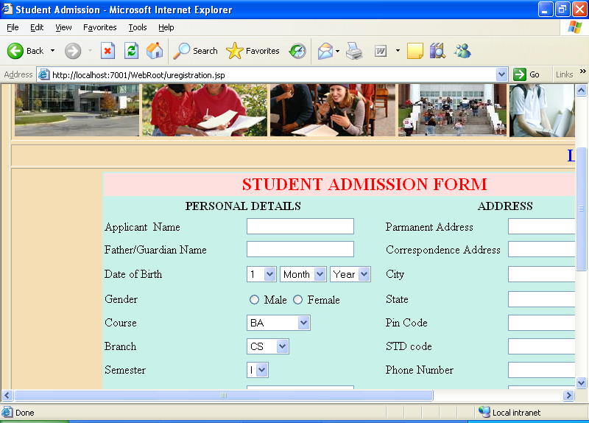

Slide 18

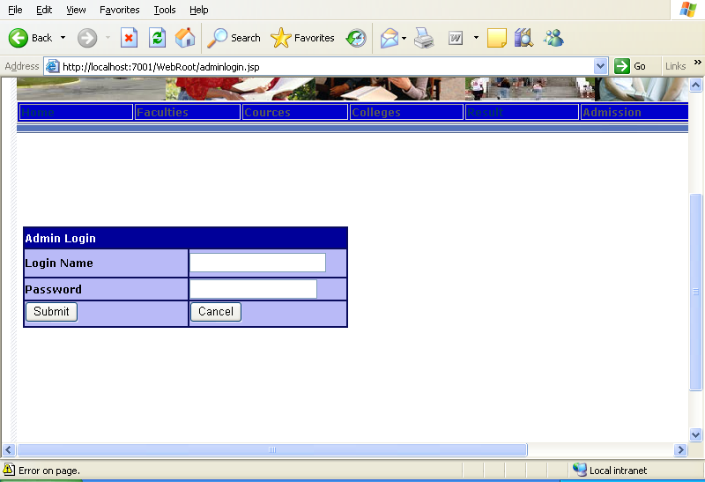

Slide 19


